Slide 1
FORMAL & INFORMAL
ORGANIZATIONS
TOPIC UNDER DISCUSSION
Concept of formal and Informal Organization
Reasons responsible for the emergence of informal organizations
Advantages and Limitations of Informal Organization
Comparison of Formal and Informal Organizations.

Slide 2
CONCEPT OF FORMAL ORGANIZATION
DEFNITION :
It is a deliberately designed structure of roles, built by the management by assigning a matching role to all the individuals, facilitating them to best attain the objectives of the enterprise.
OR
“ The formal organization is a system of well defined jobs, each bearing a definite measure of authority, responsibility and accountability “

Slide 3
CONCEPT OF INFORMAL ORGANIZATIONS
DEFNITION :
An informal organization is a social group of individuals which comes into existence automatically as result of the operation and interaction of socio-psychological factors, among the persons who are working in various capacities within the four walls of the formal organization.
OR
“Informal organization is the network of personnel and social relationship not established or required by formal organization.”

Slide 4
Reasons for the emergence of informal organizations
Desire to socialize with others.
Necessity for exchanging information.
To release boredom caused by modern specialization.
Need for collective action against the high handedness of management.
Inborn leadership.
Mutual protection under emergency situations.
Consultation on work matters.
Common link or affiliation among a group of persons.

Slide 5
Advantages of Informal Organization
In Management perspective:
  More productivity and more production.
  Communication Feedback.
  Innovation and creativity.
  More humanistic formal organization.
In Employees perspective:
  Strength against undesirable practices and actions of management.
  Management made more alert and responsible.
  Solutions to the work problems.
  Relief to emotional tensions.
  A system of self help in emergency situations.

Slide 6
Limitations of Informal Organization
In Management perspective:
  Spread of rumors
  Resistance to change
  Less than optimum production
  Problem of indiscipline
In Employees perspective:
  Role conflict
  Political domination of informal groups
  Loss of self entity

Slide 7
COMPARISION
NO: | FORMAL | INFORMAL
1. ORIGIN | DELIBARATE CREATION | SELF-GENERATING PROCESS
2 . OBJECTIVES | SPECIFIC OBJECTIVES | NO SPECIFIC OBJECTIVES
3. FUNCTIONING | ACC’ TO PREPLANNED RULES,POLICIES & PROCEDURES | NO RULES
4 . AUTHORITY –RESP R/S | CLEAR-CUT | NOT CLEAR-CUT
5 . WORK ROLE | DELIBRATELY ASSAIGNED WORK ROLE | PERSONAL ROLE OF CASUAL NATURE
6. BEHAVIOUR MOULDING | SYSTEM OF REWARDS & PUNISHMENTS | SHAPED BY CONVENTIONS ,VALUES & BELIEFS
7. LEADERSHIP | BY VIRTUE OF OFFICIAL STATUS & AUTHORITY | PERSONEL POER & PERSONALITY
8. COMMUNICATION SYSTEM | PLANNED THROUGH SCALAR CHAIN, AUTHENTIC & RELIABLE | LEAST AUTHENTIC & RELIABLE
9. STABILITY | MOST STABLE | LEAST STABLE
10. SIZE OF ORGZ’N | MODERATE OR LARGE SIZE | EXCEPT LABOUR ORGZ’N, SMALL SIZE
11. POLITICAL DOMINATION | NO POLITICAL DOMINATION | POLITICALLY DOMINATED
12. MEMBERSHIP & STATUS | MEMBER OF ONLY ONE FORMAL GP WITHIN THE OFFICIAL STATUS | VARIOUS INFORMAL GROUPS- BIG OR SMALL

Slide 8
TYPES OF ORGANIZATIONS
  LINE ORGANIZATION
  FUNCTIONAL ORGANIZATION
  LINE & STAFF ORGANIZATION
  PROJECT ORGANIZATIONS
  MATRIX ORGANIZATIONS

Slide 9
LINE ORGANIZATION
TOPIC UNDER DISCUSSION
    CONCEPT
    FEATURES
    TYPES
    MERITS & LIMITATIONS

Slide 10
DEFNITION:
Line organization is defined as that organization which has line Authority-responsibility defined in the organization structure.
Lines of authority and instructions are vertical, i.e. they flow from the top to the bottom.
The unity of command is maintained in a straight and unbroken line. It implies that each subordinate receives instructions from his immediate superior alone and is responsible to him only.

Slide 11
All persons at the same level of org. are independent of each other.
This structure specifies responsibility and authority for all the positions limiting the area of action by a particular position holder.

Slide 12
FEATURES
    The line orgz’n is governed by following principles :
    Scalar Chain of Command or line of command.
    Unity of Command
    Span of management
    No scope of managerial specialization.

Slide 13
TYPES
PURE LINE ORGANIZATION
When the organization is small and not geographically dispersed.
DEPARTMENTAL LINE ORGANIZATION
When the scale of operations of an organization is wide and is geographically dispersed activities, used for the purpose of span of management. Here each departmental managers are independent of each other.

Slide 14
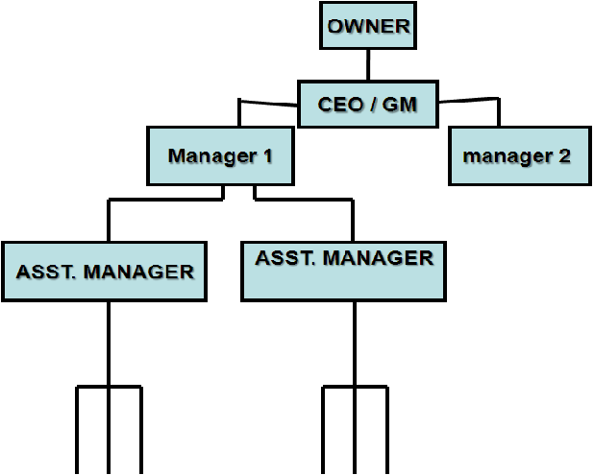
PURE LINE ORGANIZATION

Slide 15
PURE LINE ORGANIZATION
OWNER
CEO / GM
Manager 1
manager 2
ASST. MANAGER
ASST. MANAGER

Slide 16
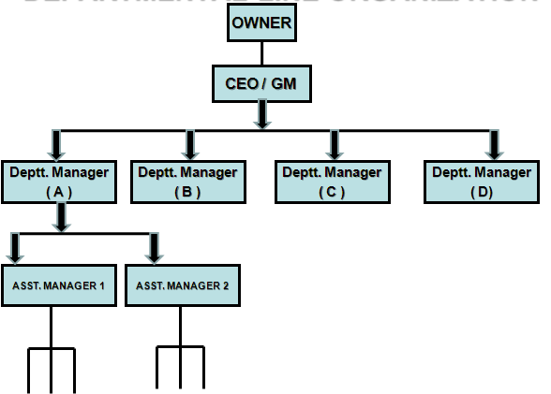

DEPARTMENTAL LINE ORGANIZATION

Slide 17
DEPARTMENTAL LINE ORGANIZATION
OWNER
CEO / GM
Deptt. Manager
( A )
Deptt. Manager
( B )
Deptt. Manager
( C )
Deptt. Manager
( D)
ASST. MANAGER 1
ASST. MANAGER 2

Slide 18
MERITS OF LINE ORGNZ’
Simple
Quick decision making
Easy fixation of responsibility
Smooth flow of work
Two-way communication
Effective management
Executive development

Slide 19
LIMITATIONS OF LINE ORGNZ’
Overload on managers
Lack of specialization
Dictatorial management
Delayed Communication
Unsuitable for large scale and in turbulent environment.

Slide 20
FUNCTIONAL ORGANIZATION
TOPIC UNDER DISCUSSION
    CONCEPT
    FEATURES
    CHART
    MERITS & LIMITATIONS

Slide 21
Concept:
In Functional organization all the business functions are divided among various activities or functions, each function entrusted with a specialist, by virtue of the expertise in a particular function and such authority is referred as Functional Authority.
The major functions of a functional organization are:
  Production
  Purchasing
  Marketing
  Finance
  Personnel
  Accounting
  Research

Slide 22
FEATURES
The functional Organization is based on the following principles:
  The principle of ‘Total Departmentation.
  The principle of ‘Precise departmentation’.
  The principle of ‘related departmentation’.
It makes use of extensive managerial specialization.
This type of organization is regulated by the ‘multiple-command-system’.

Slide 23
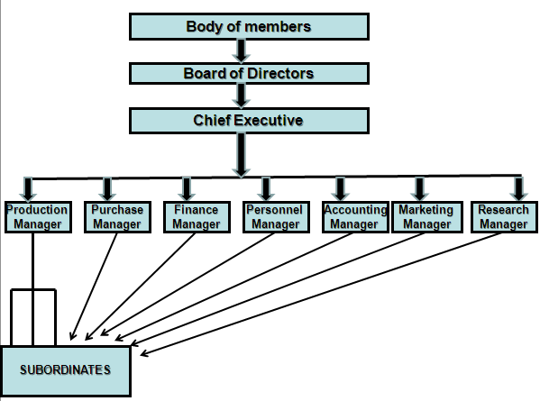
CHART

Slide 24
Functional Line
Body of members
Board of Directors
Chief Executive
Production
Manager
Purchase
Manager
Finance
Manager
Personnel
Manager
Accounting
Manager
Marketing
Manager
Research
Manager
SUBORDINATES

Slide 25
MERITS
Benefits of specialization
    Best decisions
    Increased efficiency
    Reduced cost
    Higher production
Healthy competition among experts
Dictatorial approach avoided
Suitable for large organization

Slide 26
Limitations
Drawbacks due to multiple command system :
    Confusion in subordinates
    Fixation of responsibility is difficult.
Higher cost of Administration
Narrow outlook of specialists.
Overall managerial development retarded.
Problems of co-ordination.

Slide 27
LINE-STAFF ORGANIZATION
TOPIC UNDER DISCUSSION
    CONCEPT
    FEATURES
    CHART
    MERITS & LIMITATIONS

Slide 28
LINE-STAFF Organization combines the positive features of both line organization type and functional organization into one system and is a practical type of structure with operational-efficiency.
CONCEPT
In line staff organization basic departmentation for primary business functions, operated on the concept of the scalar chain, through the provision for specialized activity performed through staff officers, and dept. heads acting just in advisory capacity.

Slide 29
FEATURES
  Scalar Chain of command
  The principle of specialization
Body of members
Board of Directors
Personnel manager
Private Secretary
Taxation Expert
Chief Executives
Public Relations Officer
Labor Expert
Accounts Officer
Cost Accountant
Advertising expert
Production
Manager
Finance Manager
Marketing
Manager
Marketing Research officer
Prodc.Engg
Subordinates
Subordinates
Subordinates

Slide 30
Line And Staff Structure
President
Legal
Office
Marketing
Market
Research
Mfg
Com-
puting
Acct

Slide 31
MERITS
Advantages due to line of command
Advantages due to managerial specialization.
Undisturbed line of command due to advisory role of the staff.
Sharing of organizational burden.
Growth of Enterprise is facilitated
LIMITATIONS
Problem of conflict
Higher Organizational costs
Problems of coordination
Over dependence on staff services.

Slide 32
PROJECT ORGANIZATION
TOPIC UNDER DISCUSSION
    CONCEPT
    DEFNITION
    FUNCTIONING
    CHART
    MERITS & LIMITATIONS

Slide 33
CONCEPT
Since the traditional organizations structures are unsuitable for undertaking big projects of technical nature due to volatile and turbulent nature
DEFNITION
A Project organization structure is created with a separate unit or division within a functional department structure with specialists and workers from various functional departments who work under the overall leadership, control and co-ordination of a project manager to complete projects of a technical nature, which are normally costly.

Slide 34
president
Production
Dept.
Finance Dept.
Marketing
Dept.
Engineering
Dept.
Research
Dept.
Project
Manager 1
Produc.
Group
Finance
Group
Marketting
Group
Engg.
Group
Research
Group
Project
Manager 2
Finance
Group
Produc.
Group
Marketting
Group
Engg.
Group
Research
Group

Slide 35
FUNCTIONING
In a project organization, a team of specialists and workers is drawn from the various functional areas, from the various functional areas of the organization to work on a project
Each project team functions under the overall control and leadership of the project manager
During the execution of the project the project manager has authority over the project team members.
On completion of the project the project team may either abandoned or the project members may be assigned roles to new projects.

Slide 36
The condition required for a project organization are:
  The project should be of technical nature.
  That which requires precision and accuracy e.g. ship-building, designing, launching of satellites, aircraft manufacture etc
  Time is a critical factor.
  The project completion has huge costs investment.

Slide 37
MERITS
Concentration on the project work
All the advantages of specialized team.
Ability to cope up with environmental influences.
Timely completion of the project.

Slide 38
LIMITATIONS
Problems of coordination due to diverse viewpoints of team specialists.
Unclear definition of the relationship between the project manger and the team specialists resulting in poor human relations in the project organization.

Slide 39
MATRIX ORGANIZATION
TOPIC UNDER DISCUSSION
    CONCEPT & FEATURES
    DEFNITION
    FUNCTIONING
    CHART
    MERITS & LIMITATIONS

Slide 40
CONCEPT
Matrix organizations are suitable for those organizations which undertake a large number of small projects
FEATURES:
  It undertakes large number of small projects.
  Dual line of command in matrix organization.

Slide 41
Matrix Structure
President
Director of
Product
Operations
Design
Vice President
Production
Vice President
Marketing
Vice President
Dp
Pp
mp
Product
Manager A
Dp
Pp
mp
Product
Manager B
Dp
Pp
mp
Product
Manager C
Authority of proj. manager
Authority of Functional head
Notes:
Projektmatrix gibt es auch!!

Slide 42
DEFNITION
Matrix organization is the imposition of project structure over the permanent functional structure of the organization, with members of project team subject to dual line of command (project manager and the concerned functional department specialist), that forms grid or matrix structure and therefore called matrix organization.
or
“Matrix organization represents a combination of functional departmental organization and project organization”.

Slide 43
FUNCTIONING
Project teams are formed drawing personnel from the functional departments
Different project managers share resources and authority with functional heads.
Each project team is associated with dual line command of project manager and concerned functional specialists.
Having completed one project the resources and personnel are diverted to the next project.

Slide 44
MERITS
Best utilization of resources
Flexible structure
Development of personnel as they are assigned with large number of projects one after the other.
LIMITATION
Confusion due to dual line of command
Conflicts over division of authority & sharing resources.
Increased paper work due to continuous communication horizontally (proj. manager ) and vertically(from functional heads)
Problem of adjustment.

